Slide 1
Ghost fluid methods – part 2
Stephen Millmore
Laboratory for Scientific Computing

Slide 2
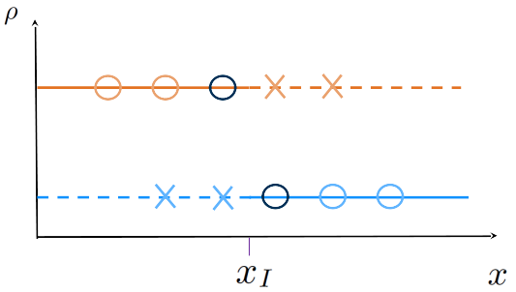
Riemann problem-based ghost fluid methods
When we last discussed ghost fluid methods, we stated that Riemann problem-based methods could be used to provide dynamic boundary conditions
We shall return to the configuration where we have identified states adjacent to the interface, and wish to ensure that the ghost fluid region is set correctly for wave interactions to be reproduced

Slide 3
Outline
Riemann problems and the ghost fluid method
Mixed-material Riemann problems
Ghost fluid methods in multiple dimensions

Slide 4
Outline
Riemann problems and the ghost fluid method
Mixed-material Riemann problems
Ghost fluid methods in multiple dimensions

Slide 5
Generalising a Riemann problem to two materials
Perhaps the first question we should address is why we can consider mixed-material Riemann problems in the first place
We start with a single material, three-wave solution

Slide 6
Generalising a Riemann problem to two materials
When we originally derived the Riemann problem solution, we did so assuming each initial state obeyed the Euler equations
We did not say that each initial state had to have the same equation of state though (we just assumed that they did)

Slide 7
Generalising a Riemann problem to two materials
If the two materials had different equations of state, we already know that the interface moves with material velocity, i.e. behaves like a contact discontinuity
Therefore we'd simply end up with one intermediate state coming from one material, and one from the other

Slide 8
Generalising a Riemann problem to two materials
Mathematically, this works out too
There are two functions that depend on either only on the left state or only on the right state

Slide 9
So what makes this a suitable boundary condition?
It is clear that the solution to the Riemann problem is going to be a physically valid state
But we want to consider why it is then a suitable ghost fluid state, which is slightly different, since the cell boundary doesn't move at all

Slide 10
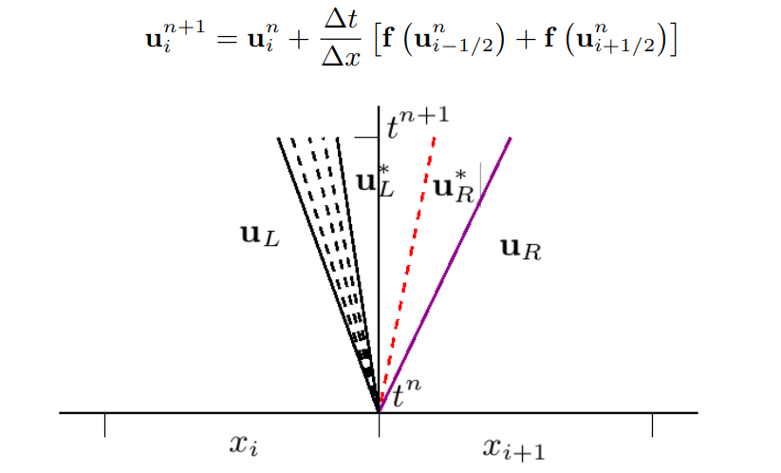
What do we need from our ghost fluid method
The aim of our boundary conditions is to ensure that we get fluxes for each material at the interface correct

Slide 11


What do we need from our ghost fluid method
Both right-hand states here produce the same left-moving wave, and the same behaviour at the cell boundary
This ghost state is clear

Slide 12


What do we need from our ghost fluid method
Both left-hand states generate the same right-moving wave, though the state at the cell boundary is different
Is this ok?

Slide 13
What do we need from our ghost fluid method
Provided the left-moving wave doesn't cross the cell boundary, yes
In this case, as well as the correct right-moving wave, we ensure the correct movement of the contact discontinuity
Original GFM approach for a moving contact

Slide 14
What do we need from our ghost fluid method
If we have a situation where additional waves cross the boundary, we are really revealing one of the weaknesses of the single material-per-cell approach
The practical GFM does make some attempts to rectify this, but this is still an underdetermined problem

Slide 15
Do we need to improve ghost fluid methods?
Despite these weaknesses, Riemann problem-based ghost fluid methods have been used successfully for interfaces between solids, liquids, gases and plasmas
And most of the issues do still converge away as resolution increases
And the fact that the ghost fluid states are definitely thermodynamically reasonable is enough to ensure stable behaviour, just perhaps slightly changing the problem being solved
The obvious improvement, whilst maintaining the sharp interface nature of the problem is multimaterial cut cell methods
These are being actively developed, but are still very much research – how do you provide cut cell boundaries over a time step in which the boundary moves?

Slide 16
Outline
Riemann problems and the ghost fluid method
Mixed-material Riemann problems
Ghost fluid methods in multiple dimensions

Slide 17
Mixed-material Riemann problems
We have already hinted at the fact that mixed-material Riemann problems are mathematically supported by everything we have covered so far
And, fortunately, they are not actually any more complex to solve

Slide 18
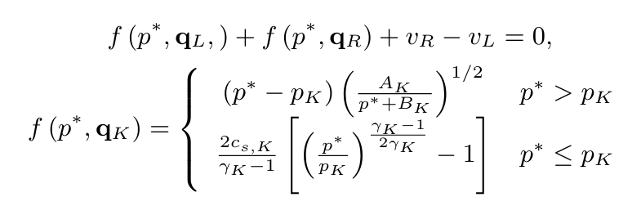
Ideal gas interface REORDER ANIMATION
The 'simplest' interface is between two ideal gases, and, for this, we can still compute the exact solution
The only difference between this and the method introduced in Numerical Methods for Compressible Fluid Dynamics is that the left and right states each use their own material's
Additionally, the two-rarefaction solution can no longer be directly analytically obtained, an iterative solution must always be used
These terms also contain
Now have material dependence

Slide 19

Stiffened gas interfaces
Ideal gas interfaces are relatively uncommon in short-time scale sharp interface problems
Gas-liquid or liquid-liquid interfaces are much more common, as these will often remain sharp
It is possible to perform the derivation of the exact Riemann problem solver for the Euler equations with a stiffened gas EoS
Doing this only slightly changes the eventual expression

Slide 20
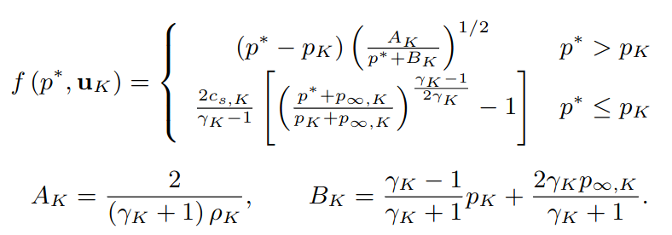
Stiffened gas interfaces
This is no more challenging to solve than the ideal gas version; even for a Newton-Raphson method, the derivatives are still straightforward
In the case of a gas-liquid liquid interface, one of the materials simply needs

Slide 21
General interfaces
As we move to more complicated materials, and systems of equations, we do not always have explicit forms relating the initial states to the star states,
And when we do, these require solution techniques which are neither fast nor reliable for computing the star state (e.g. exact MHD solvers)
Approximate Riemann solvers can be constructed, provided they do resolve the contact discontinuity (HLL is not a good idea)
But, because the intermediate state is chosen only for consistency of the underlying equations, it does not guarantee the correct mixed-material behaviour
Oscillations and larger errors are therefore often seen if attempting to use an approximate solver (based only on obeying the consistency condition)

Slide 22
General interfaces
Interfaces involving solid materials are even more difficult - ‘pressure’ in a solid is defined through a stress tensor, not a scalar variable
However, behaviour at contact discontinuities, i.e. across the interface, is known, and, providing we have a means of specifying intermediate states, we can determine boundary conditions
An alternative approach to using exact solutions is to solve a linearised Riemann problem
This uses the ideas some of the early GFM improvements, and, although technically an approximation, it attempts to approximate the actual solution, rather than the finite volume behaviour of the solution
And once an initial guess has been made, iterative methods exist to improve the solution guess

Slide 23
A complex-interface example
In order to look at linearised techniques for finding mixed-material Riemann problem solutions, we shall look at a complex example
We shall consider all the things which could make this a challenge
Different numbers of equations for each material
"Different" conserved variables for each material
Considering stress and pressure at the interface
Allowing for diffuse interface formulations at the interface

Slide 24
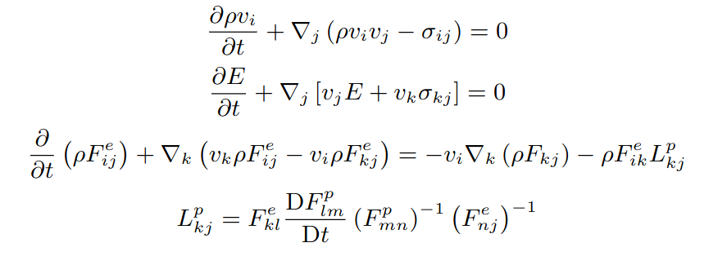
A complex-interface example
Our first material will be an elastoplastic solid

Slide 25
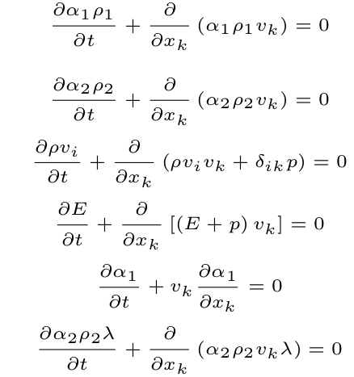
A complex-interface example
Our second material will be a diffuse interface between two liquids/gases, where one of them may be reactive
Source terms are solved independently, we don't consider them

Slide 26
Intermediate state behaviour
Our linearised solutions will not change the fact that we have a material interface
This means it will always move with a single velocity, and the normal velocity is constant across the interface
When dealing with stress tensors, we can always work out a component of the stress tensor which is normal to the interface
This must also remain constant across the interface
This still holds for solid-liquid or solid-gas interfaces, where the pressure is the only component of the stress tensor
This is then sufficient for computing linearised states for any combination of materials

Slide 27

Linearising the solution
Linearised solutions start from the characteristic form of the equations
Previously, we have said that this is not an easy form to work with for complex, nonlinear systems of equations
However, linearising this equation means we assume is constant
Clearly this is a big assumption, though in the limits of small space and time steps, it is reasonable
Unless, of course, we have nonlinear behaviour...

Slide 28



Characteristic form of the mixture equations
Recall that for obtaining the characteristic form, what we actually need is the primitive variable form of the equations, and some eigenvectors
Whilst we have seen each of these equations in primitive form previously, this is not the form we shall use here
Instead, it is more convenient (it turns out) to use

Slide 29
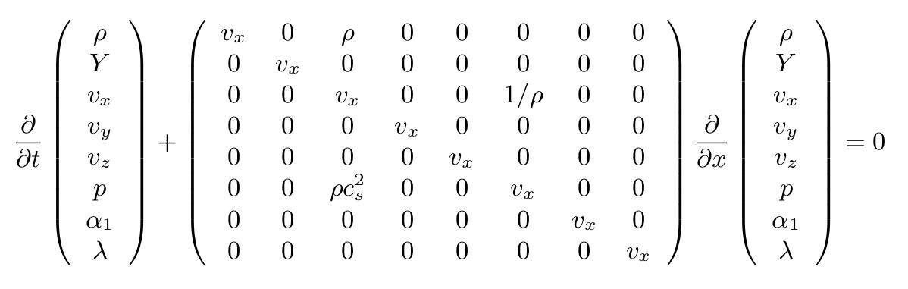
Primitive variable form
We now need the eigenvalues and eigenvectors of this system
The eigenvalues are, as expected,

Slide 30
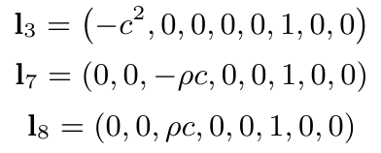
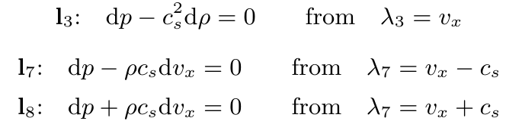

Eigenvectors
The eigenvectors for this system are also very familiar, the only three 'interesting' ones are no different to those for the Euler equations
And from these, we have characteristic variables
All other characteristic variables are trivial, e.g. along

Slide 31
Characteristic variables
When we first introduced these characteristic variables, we could not easily simplify things
Under the linearised assumption, however, these terms are all constant
As a result, the integration step now becomes trivial
We can use this to approximate an intermediate state based on the left and right states

Slide 32
Characteristics
Much like when deriving the solution to the exact Riemann problem, we can consider jumps across waves
From the right-hand state, we have three characteristics
Two of these definitely intersect the right-moving wave
The third might meet it (shock wave), but not under linearised assumptions
Solid
Diffuse mixture

Slide 33


Characteristic jumps
Much like when deriving the solution to the exact Riemann problem, we can consider jumps across waves
Solid
Diffuse mixture

Slide 34
Using the characteristic jumps
Exactly as we had in the exact Riemann problem solution, we now have information about the intermediate states based on the initial states
And, as we would expect, across the interface, we still have
All we need to do is find the equivalent relationships for the waves moving across the solid (and to get to the intermediate state closest to the interface)
Clearly this could be a lot more work – worth trying an approximate Riemann solver (under caveats about physical intermediate states)?

Slide 35
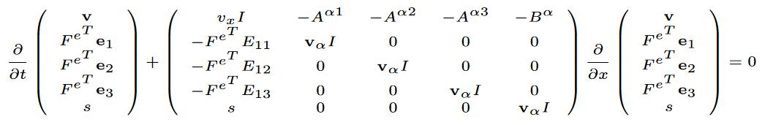
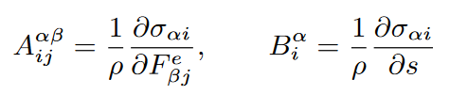
Characteristic form for an elastoplastic solid
We have seen that the elastoplastic solid equations can be written in primitive variable form – one reduced way of writing this is
A lot of terms within the matrix have been left in ‘matrix’ or ‘vector’ form (see Matter under Extreme Conditions for the full matrix)
To get characteristic form, all we need to do is compute the eigenvectors…

Slide 36
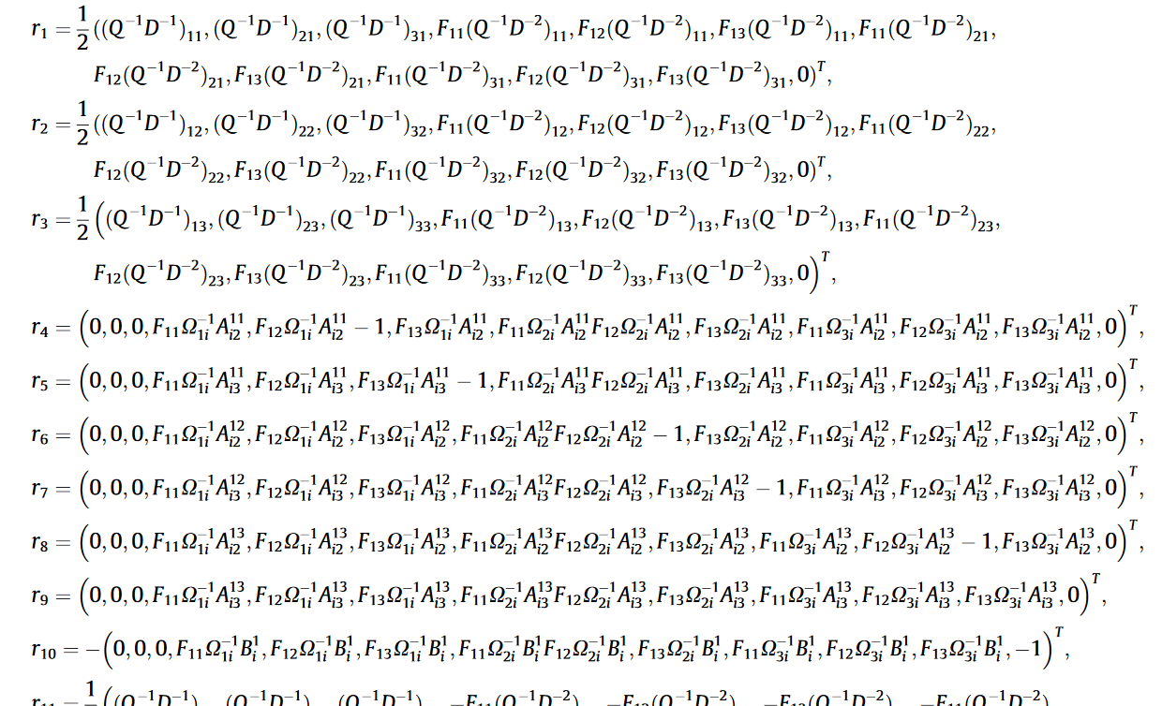
The eigenvectors…
Barton, Drikakis, Romenski and Titarev (2009)

Slide 37
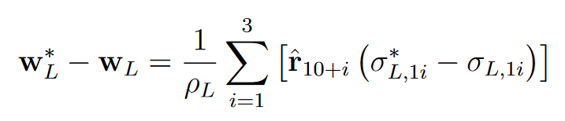
Obtaining intermediate values
At this point, we are extremely fortunate someone has done the work for us
Jumps in the primitive variables across the waves are given by (see Barton and Drikakis (2010))
Three of the thirteen eigenvectors
Stress components (assuming the interface is aligned with the x-axis)
The jump in all normal stress components needs to be specified to be able to compute boundary condition states
Only non-trivial complicated for solid-solid interactions, otherwise

Slide 38



Intermediate pressure
We can, eventually, get to a single intermediate pressure (see Michael and Nikiforakis (2018) for more details)
Here, we have the elastic acoustic tensor
And for the solid
So, although the equations are messy for this combination, the linearised method does provide an explicit calculation of intermediate values

Slide 39

Using linearised solvers
This technique allows us to derive boundary conditions for arbitrary interfaces (for any new system, “just” compute the eigenvectors and values)
Clearly, there is a large assumption behind this approach – the primitive variable matrix is constant
For ‘mild’ problems, this assumption is suitably accurate to give good results –therefore useful for testing the implementation of a new system
For ‘extreme’ problems, the linearised solver may fail; the estimation of intermediate states around shock waves could be entirely wrong, and oscillations or unphysical states occur
In this case, we want to relax the assumption that

Slide 40
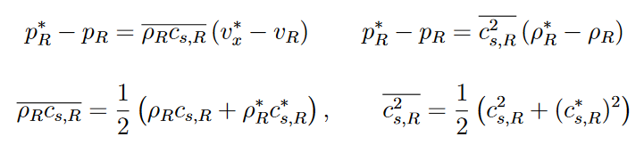
Using linearised solvers
The simplest extension of the linearised approach is to slightly restrict the assumption that the primitive variable matrix itself is constant
Instead it is some form of average of initial and intermediate states; for these expressions we could have
Unfortunately, we don’t have a closed expression any more, and we need a (relatively straightforward) iterative approach, see Schoch and Nikiforakis (2013) for details

Slide 41
Outline
Riemann problems and the ghost fluid method
Mixed-material Riemann problems
Ghost fluid methods in multiple dimensions

Slide 42
Considerations in multiple dimensions
So far, we have only considered one-dimensional interfaces
In more than one dimension, we cannot expect our interface to be aligned with the numerical grid
In this case, we have additional considerations:
Only normal velocity (and stress) is continuous across an interface – how do we enforce this?
If we are using a Riemann problem-based method, for a given left state, how do we determine what the adjacent right state is?
How do we propagate information into the ghost fluid region?

Slide 43



Obtaining the normal components
In order to obtain the velocity normal to the interface, we need to know what direction the normal points in, which, fortunately, is straightforward
The normal component of the velocity is then
The normal component of a vector is a scalar, and similarly, the normal component of a rank-two tensor is a vector
For example, we may also need the normal component of stress at an interface

Slide 44


Obtaining the tangential components
Once we move to multiple dimensions, we need to provide boundary conditions for tangential components at the interface, not just normal components
As we saw when considering the solutions to Riemann problems in more than 1D, the intermediate states for tangential components were trivial, since they only jump across the contact discontinuity
This doesn’t change, now they only jump across the interface
We could use our normal vector to decompose our full velocity (or stress) field into a coordinate system where one component is normal to the interface
This would be a lot of work, though, and is not necessary; instead we maintain our regular Cartesian condition, and simply subtract normal contributions

Slide 45
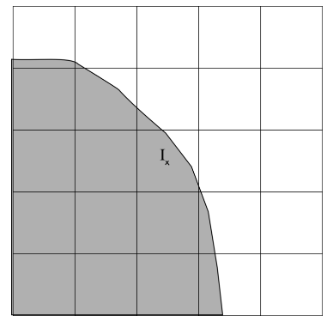
Basic ghost fluid in multiple dimensions (part 1)
The basic ghost fluid is relatively easy to extend to multiple dimensions
The copying of the pressure is entirely unchanged from 1D, and the copying of velocity becomes the copying of normal velocity
The local normal direction can be used for all velocity copying – close to the interface, this is sufficiently accurate (and far away it doesn’t matter)
Entropy must now be extrapolated using some extrapolation algorithm (we shall come to this)
The full tangential velocity vector must also be extrapolated in the same way

Slide 46
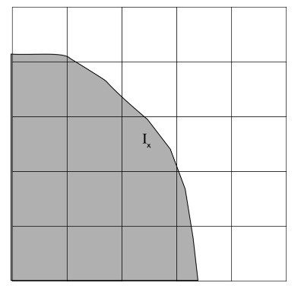
Riemann problem-based ghost fluid methods
We need to be able to set up a Riemann problem between two states either side of the interface
First we identify a cell adjacent to the interface
As with reinitialisation techniques, this is done by comparing the sign of the level set function in adjacent cells
In this example, we have found a cell with two adjacent cells in the other material
Is either of these a good choice for the Riemann problem state?

Slide 47
The real ghost fluid method
This is where we see some differences in the Riemann problem-based ghost fluid methods
The real GFM will attempt to pick the single, ‘most suitable’ cell from all adjacent cells
?
?
?
?
?
?
?
?
In this 2D example, we have eight possible choices
Clearly, any cell which is the same material can be ignored
The cell which then aligns most closely with the normal vector is chosen
Note that this cell is not actually adjacent to the interface itself – every cell must be considered individually

Slide 48
The Riemann ghost fluid method
?
?
?
?
?
One potential issue with the real GFM is the two states for the Riemann problem are a different distance from the interface
The Riemann GFM attempts to correct for this, but this requires using more than one cell
Therefore information could come from any cell suitably close to the interface (within two cells – everything in this example!)
?
?
?
?
?
?
?
?
?
We could simply use information about the normal direction to find a position about which to interpolate
However, in this example, the interpolation should use four surrounding cells – here there are only three in the correct material

Slide 49
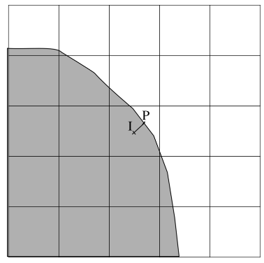
Interpolating neighbouring cells
We now aim to find two interpolated states, equidistant from the interface
Therefore we first need to find a point on the interface, and the closest point to our cell
Fortunately, the use of signed distance functions is once again an advantage – this tells us both the distance to the interface, and we can compute the direction (the normal)
Therefore we simply have a location
Note – this has made an assumption that the normal vector is pointing into the grey region

Slide 50
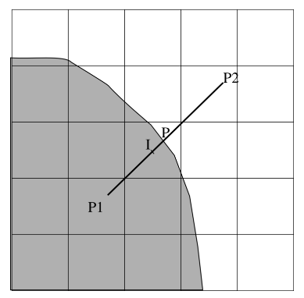
Interpolating neighbouring cells
Once we’ve identified our interface position, we now use this to compute two positions equidistant from the interface along the same normal vector
This means that for the Riemann GFM, both initial states must be interpolated
We now have two positions, each a distance from the interface
Ideally, this distance should be the shortest such that both materials have an interpolated state from four valid cells (whilst not being too far away)
In practice, it is common to use , as this usually gives suitable points

Slide 51
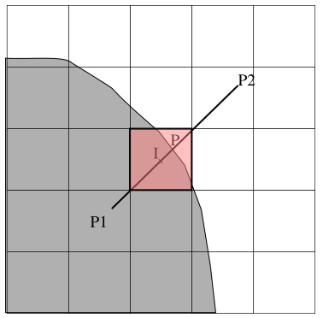
Obtaining the Riemann problem solution
In order to interpolate the states, a bilinear interpolation is sufficient (higher order puts you too far from the interface)
Once we have these states, the normal vector can be used to rotate them normal to the interface
And then we solve the mixed-material Riemann problem
Here, we are finding a ghost fluid state for the white material (from P2)
In practice, we always set this material as the left material, and then use the left star state (the same applies to the real GFM)
This is slightly different from how the original Riemann GFM was implemented, but a more natural extension to multiple materials

Slide 52


Solving the Riemann problem
In order to obtain our Riemann problem solution, we could rotate all vectors and tensors to be normal to the interface, e.g.
The Riemann problem solution would then include velocities
However, as mentioned earlier, we can do this whilst avoiding identifying what the tangential vectors are
And then we get star-state velocities
This may require very slight changes to existing Riemann solvers

Slide 53


Populating the ghost cells
All the multidimensional techniques so far have considered how we set values in cells adjacent to the interface
Now we need to consider extrapolating these values
For the basic ghost fluid method, we compute interface quantities which we use to compute ghost fluid values
These come from the real material
Extrapolate these quantities
And use them to compute these

Slide 54
Populating the ghost cells
All the multidimensional techniques so far have considered how we set values in cells adjacent to the interface
Now we need to consider extrapolating these values
For Riemann problem-based ghost fluid methods, we have the entire intermediate state for the first line of ghost cells
We don’t need to compute anything further, just extrapolate

Slide 55



Populating the ghost cells
In order to fill ghost fluid boundary states, we need to perform a constant extrapolation
We consider an arbitrary variable, , which needs extrapolating – this could be any of the quantities from either type of ghost fluid method
Constant extrapolation is the solution to a boundary-value problem
There are similarities here to the Eikonal equation, which could be written
As a result, the techniques for solving this equation are equally similar, and require very little modification from a reinitialisation procedure

Slide 56

Populating the ghost cells
Although the techniques are similar, we are not solving an Eikonal equation
Here, the information about the normal vector comes from the level set function, which we already know
However, this only makes things easier, and we can still use iterative, fast marching or fast sweeping methods
To briefly mention fast marching methods, before considering the other two approaches:
If we already know the level set function, we already know the order to which we march through the domain, and all derivatives are derivatives of

Slide 57


Populating the ghost cells – iterative approach
As before, all derivatives are first order upwinded calculations
However, here, upwind means in the direction of the interface, so is still based on the level set function, not
Again, only ‘enough’ iterations need to be performed, Fedkiw et al. say about 20 iterations is sufficient for boundary conditions

Slide 58


Populating the ghost cells – fast sweeping
Again, the level set is used to define the upwinded coefficients, e.g.
And in this case, rather than solving a quadratic, this is a simple linear equation

Slide 59
Going beyond two materials
Everything we have considered so far has been a multiphysics method for two materials (though we have combined some of these)
This is not a restriction of these methods, just a convenience
By including additional equations for volume fractions, densities (and maybe momenta and energies), diffuse interface methods can be trivially extended
Mixture rules may become trickier, and identifying primitive variables can become a challenge which may require iterative root finding
Sharp interface methods simply need an extra level set equation and material system of equations for each material
Care must be taken to ensure each cell in the domain belongs to a unique material – level set fix-up algorithms exist to ensure this

